Slide 1
MTA Data Analysis of NYC Subway for WTWY
By Eddy, Yingzhao and Ashvine
17 April 2020

Slide 2
Objectives
Our goal is to help WTWY teams in achieving maximum email signups.
This will help them increase their fundraising on the gala night.

Slide 3


Methodology
Using the New York City subway data to analyse transit patterns of commuters in order to optimize WTWY team placement.
We analysed one week’s worth of turnstile data from the MTA datasets and given our short time frame, we used a minimum viable product (MVP) approach to come up with a simple, workable and value-added product.
We used data from the top 5 busiest stations for a period of 24hours for each day of the week.
For each station, we added both their entry and exit data.
Data analysis with

Slide 4

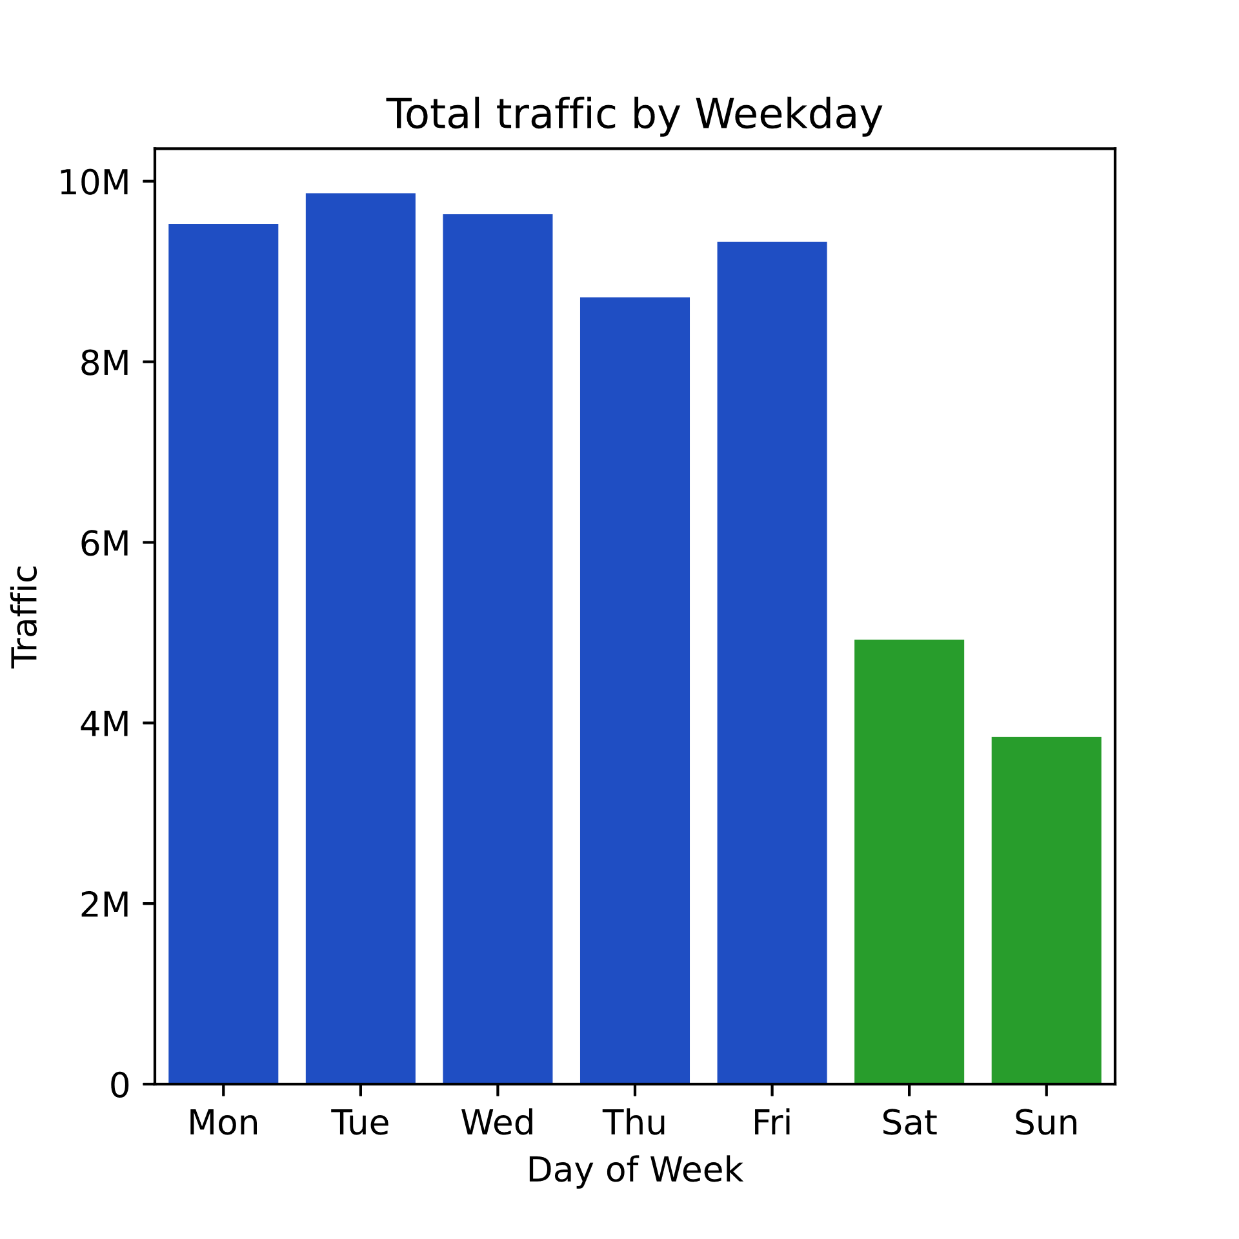
Key Findings
Weekends generally see less traffic
Weekdays generally see more traffic

Slide 5
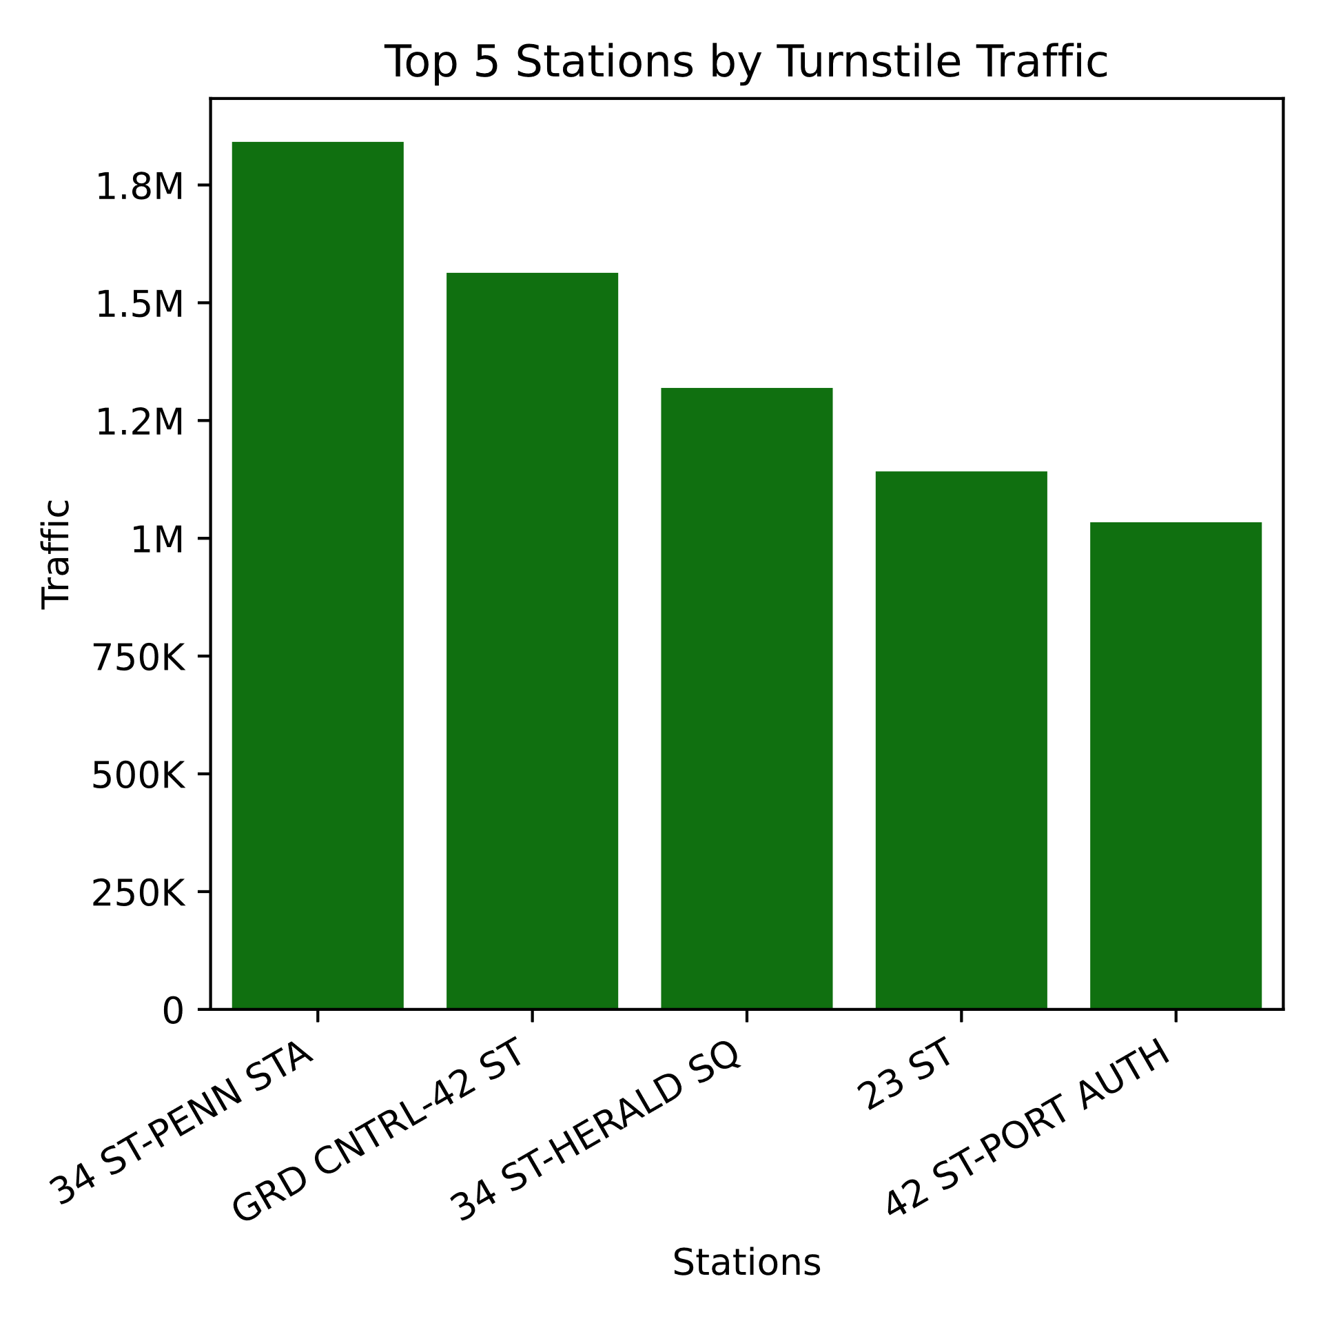
Key Findings
Top stations are the following:
Penn Station
Grand Central
Herald Square
23rd Street
Port Authority

Slide 6
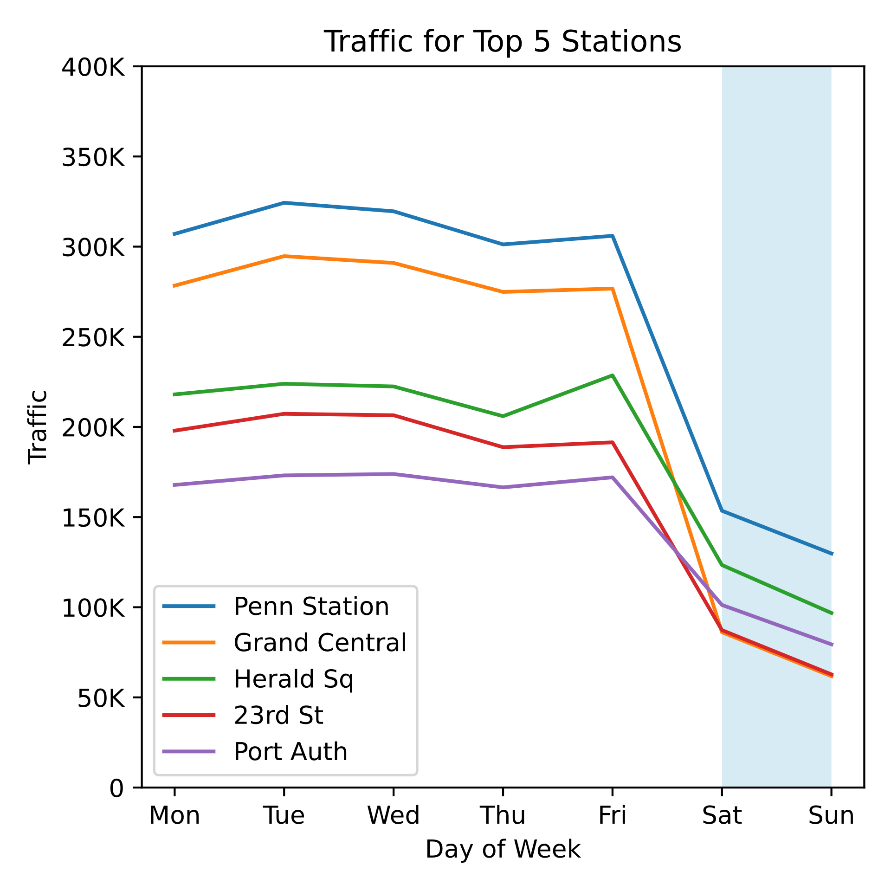
Key Findings
All five stations have similar patterns of traffic
low on weekends (blue highlight)
high on weekdays

Slide 7
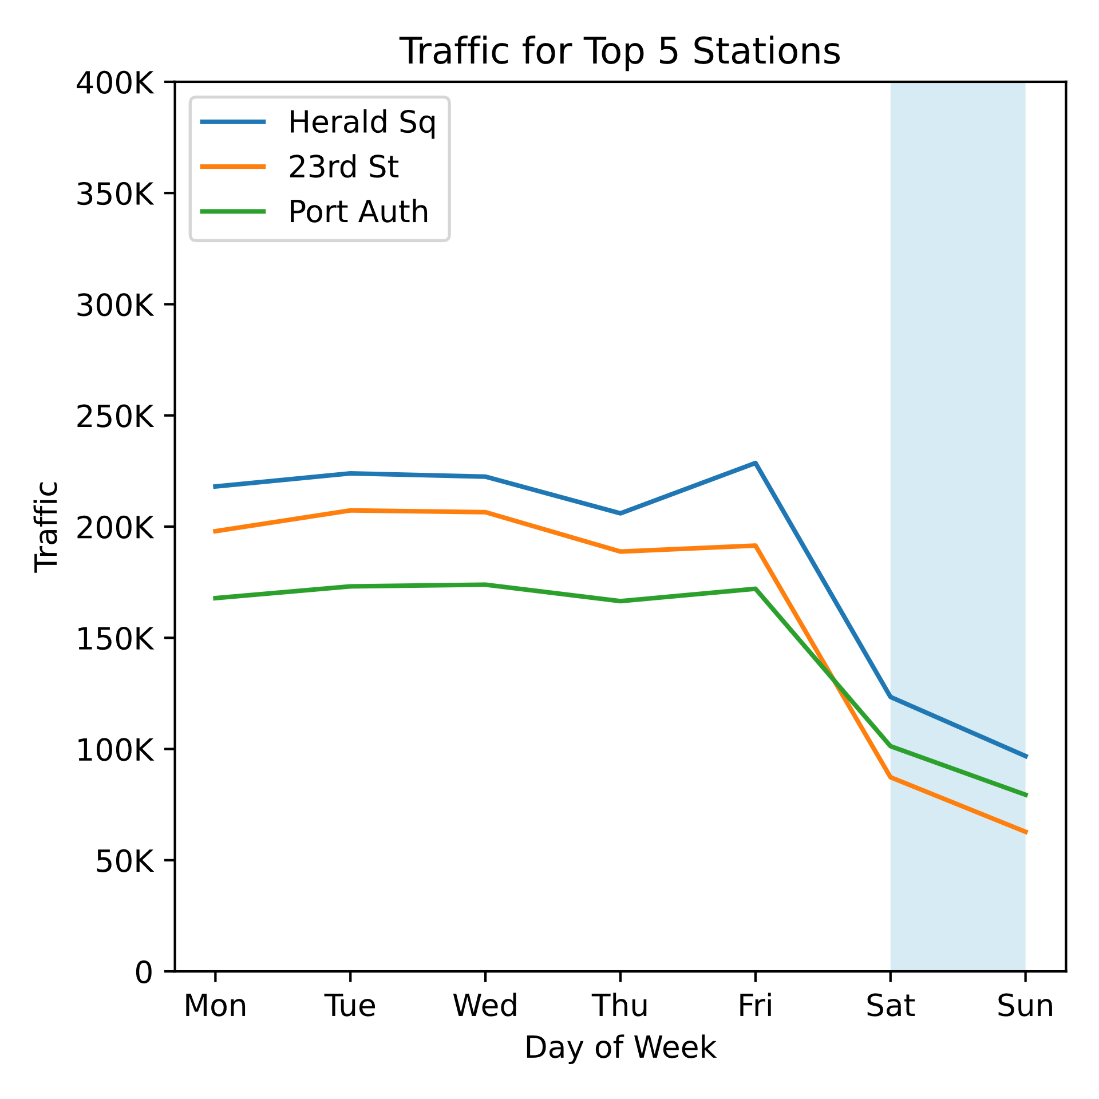
Key Findings
All five stations have similar patterns of traffic
low on weekends (blue highlight)
high on weekdays
Some stations have noticeably flatter traffic patterns than the other stations
May be due to stations being in or near tourist areas

Slide 8
Next Steps
We can conclude that using data analytics will effectively enhance the signup rate by optimizing the deployment of the street teams. This should hopefully translate into higher funds collected on WTWY gala night.
We must look at a larger data frame to fine tune our analysis and uncover other relationship that can enhance our results.
We can also analyse our data by different times of the day(e.g. morning and afternoon peak hours), different station locations (tourist hotspots vs business districts) and weekdays and weekends.

Slide 9
Thank You

Slide 10
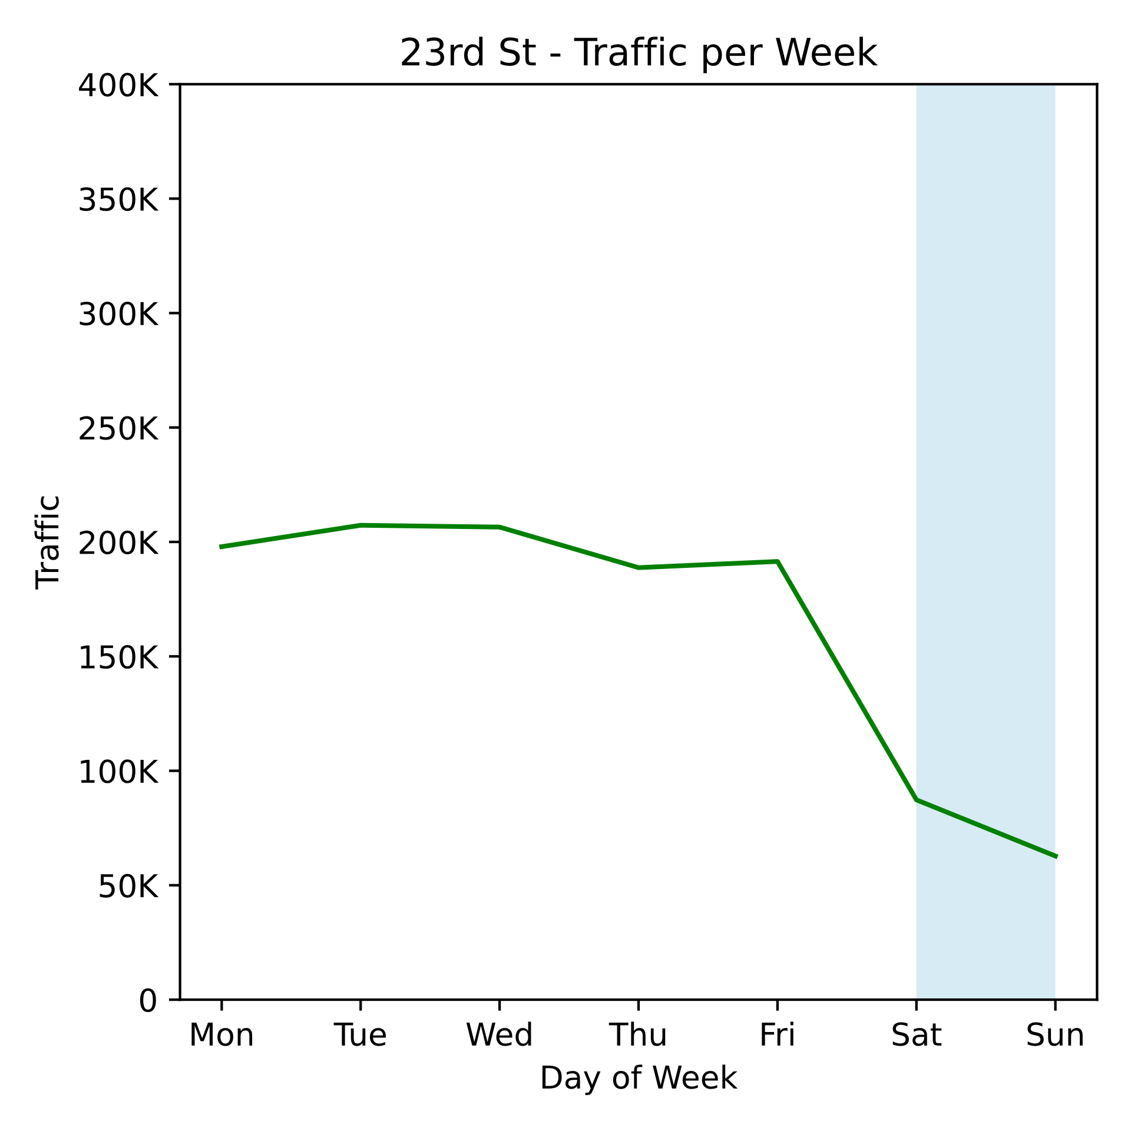
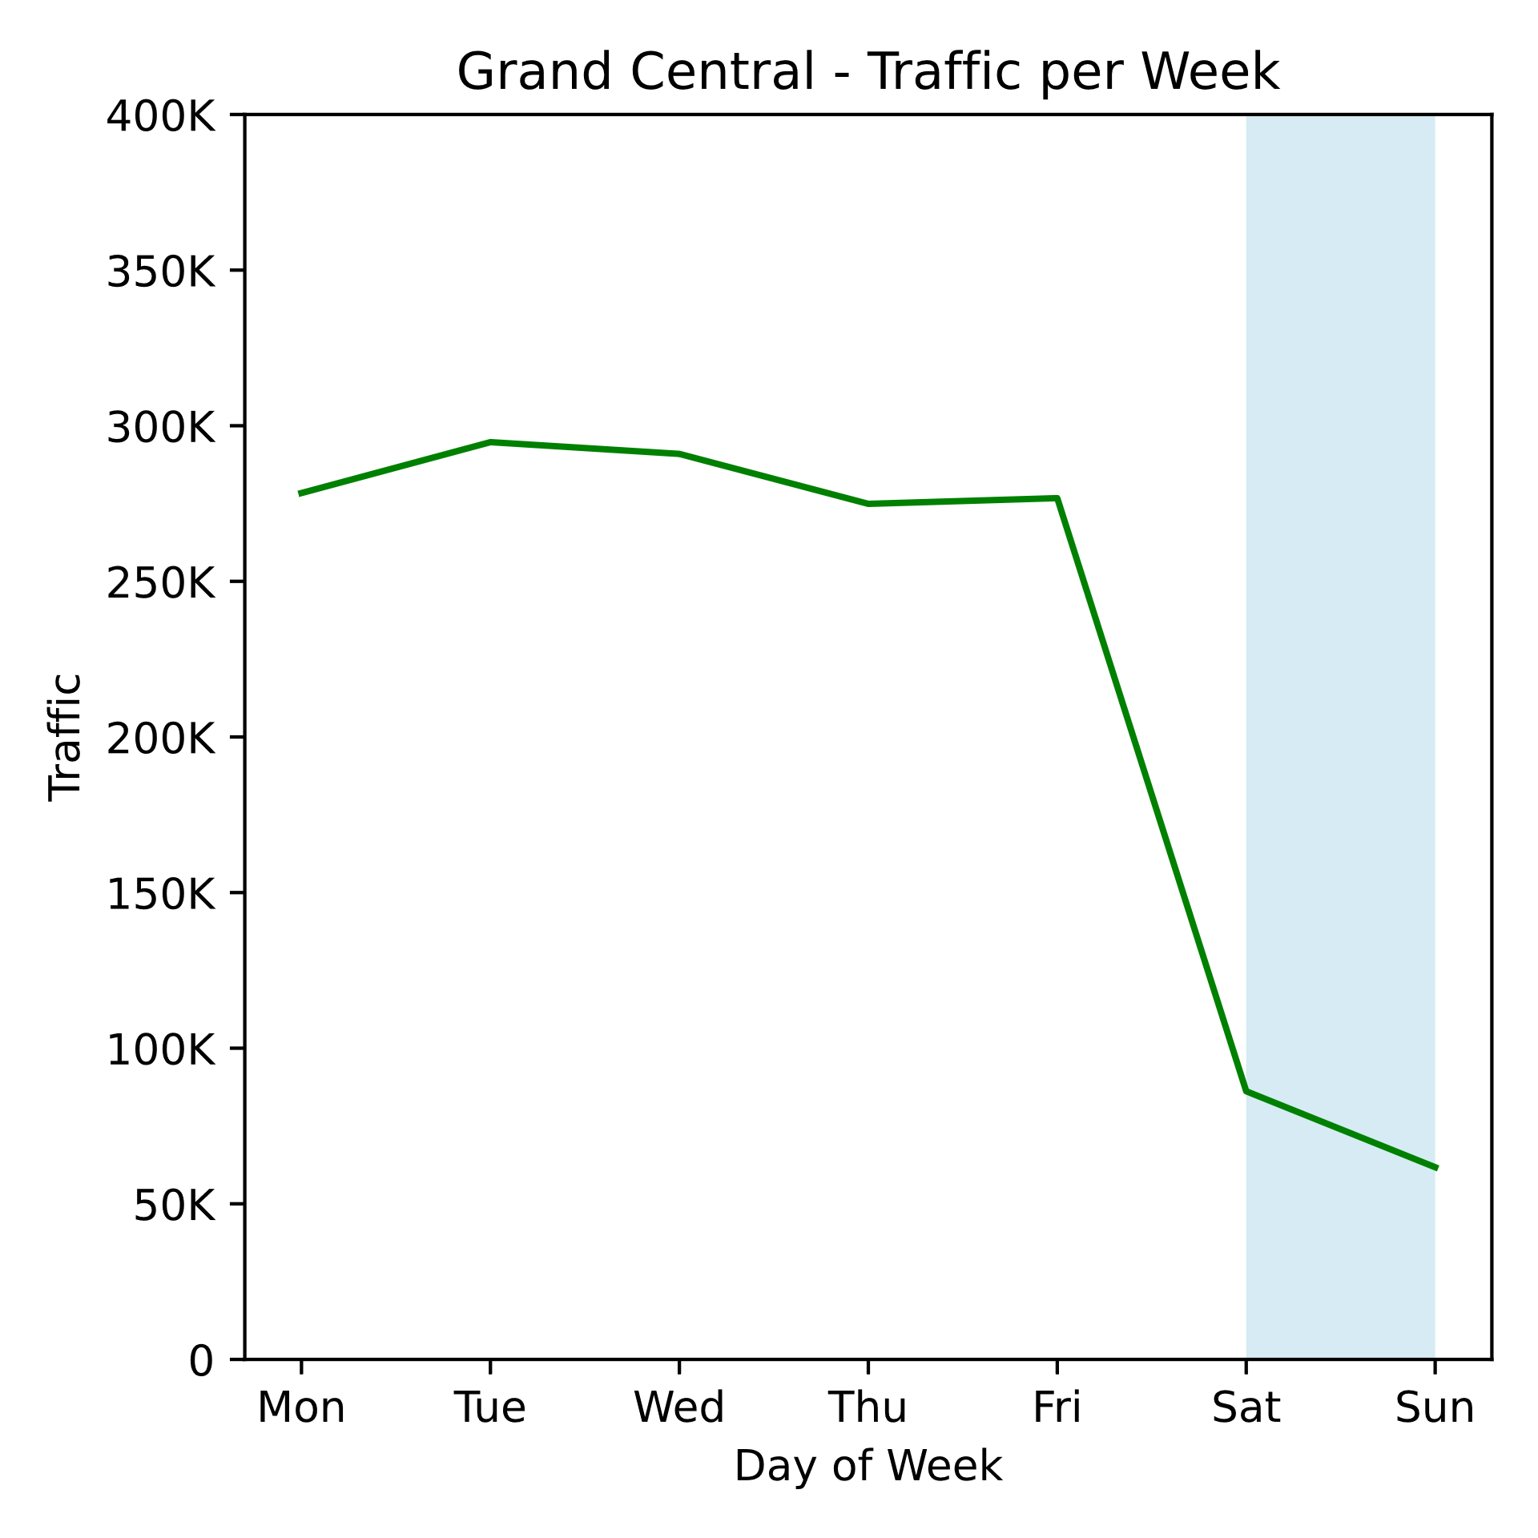
Appendix 1 – Entries for each station

Slide 11
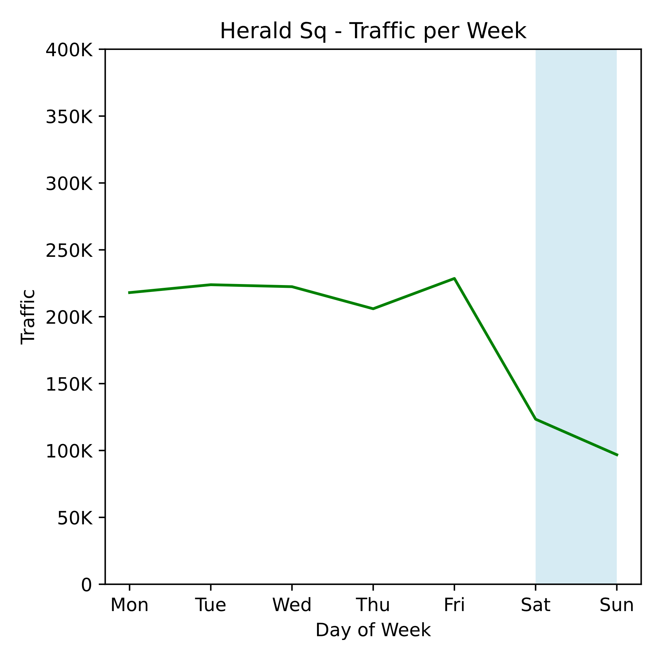
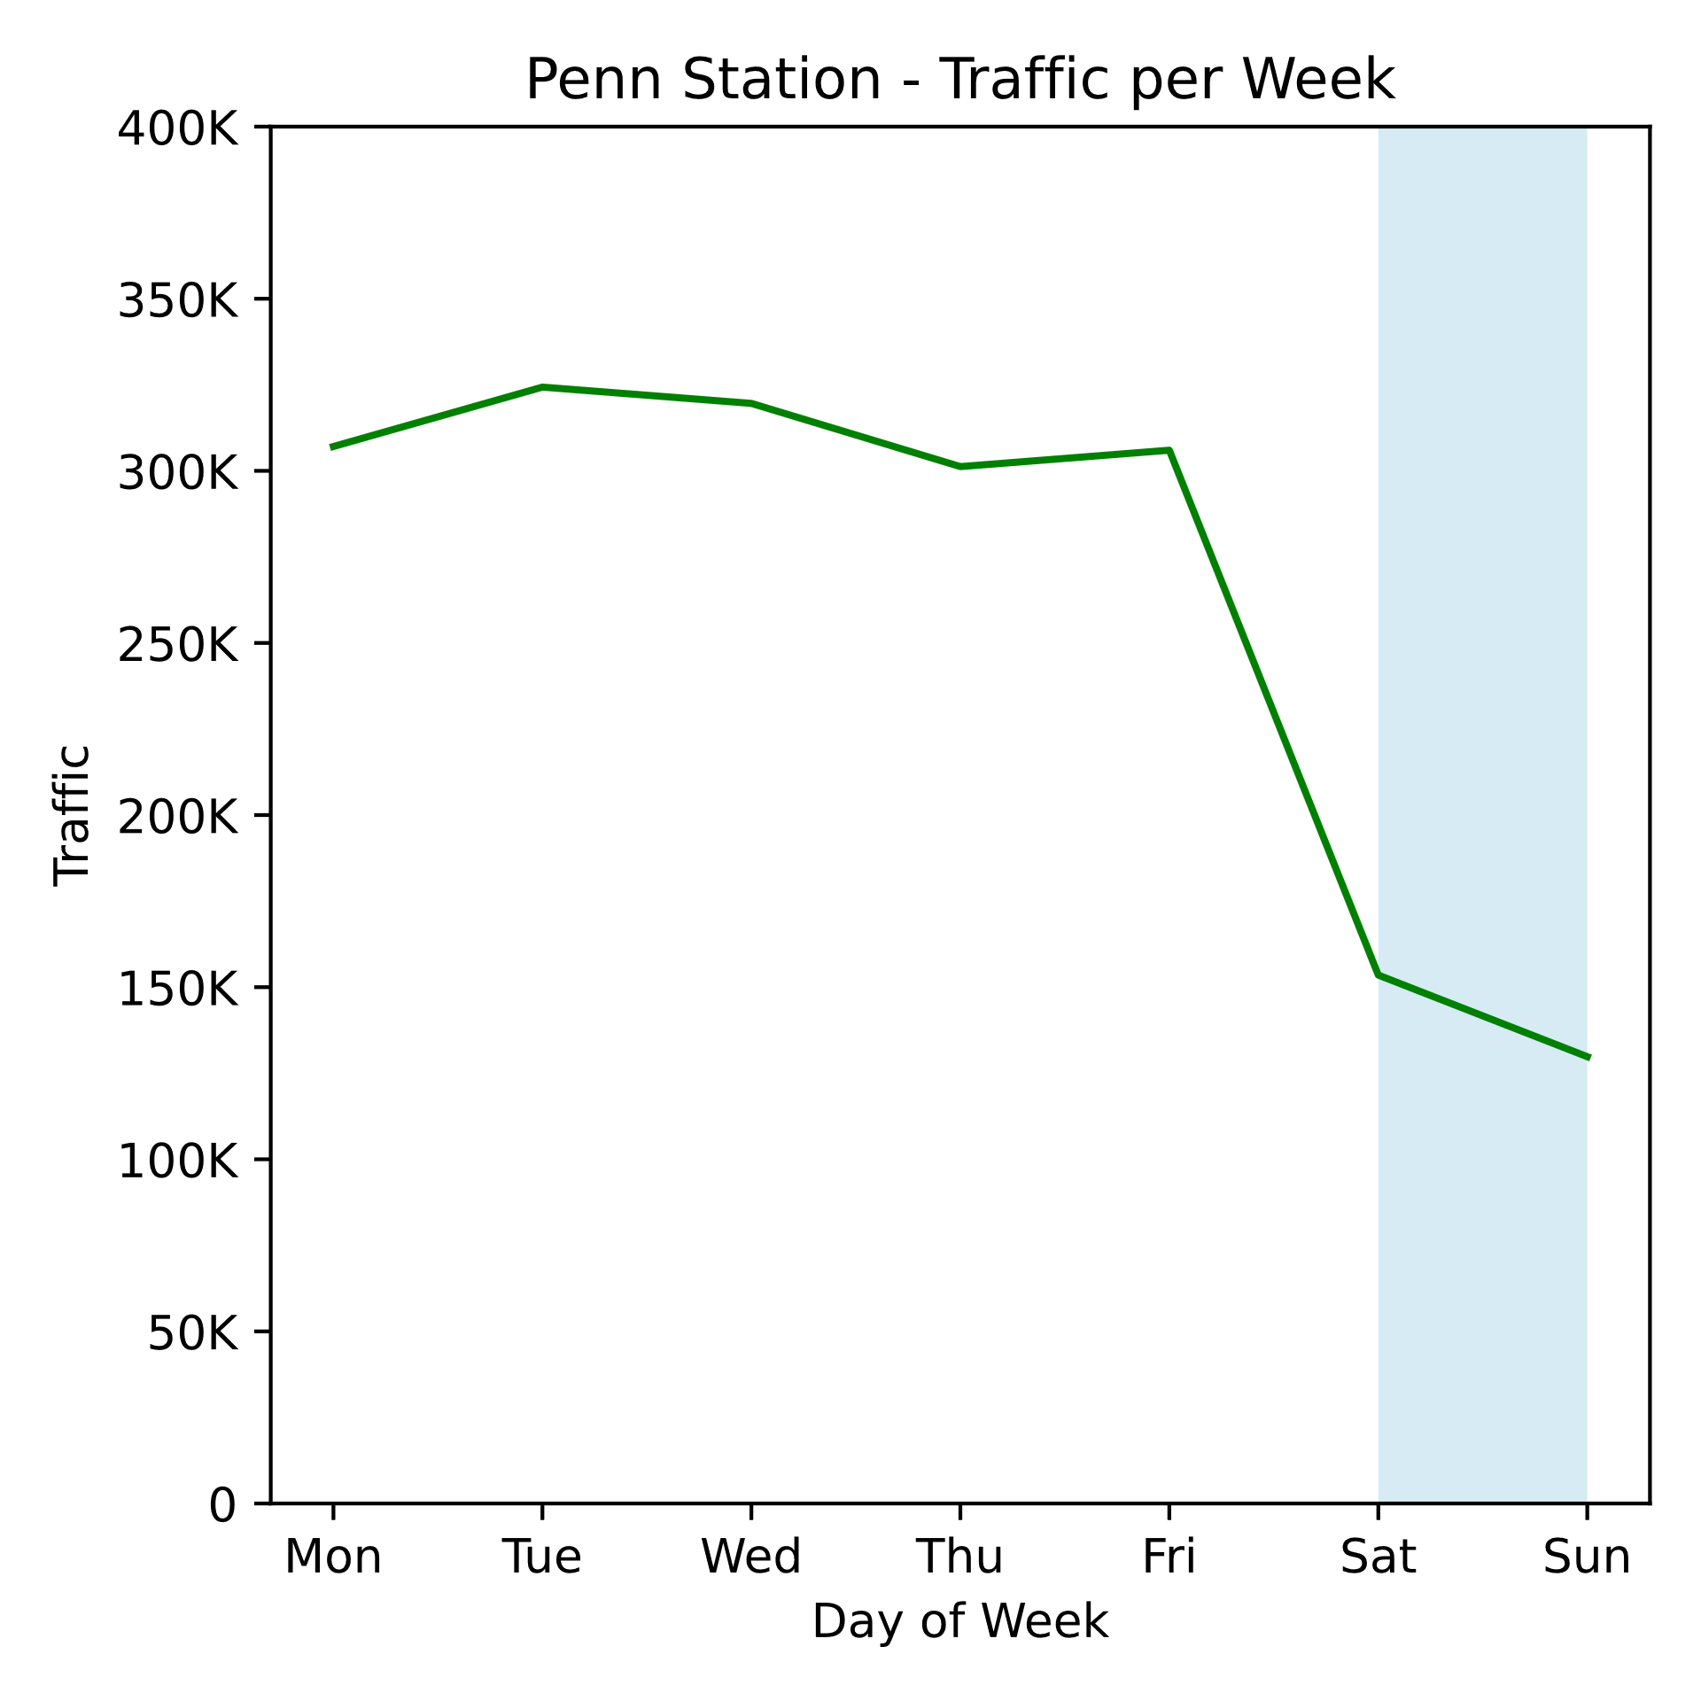
Appendix 1 (contd)

Slide 12
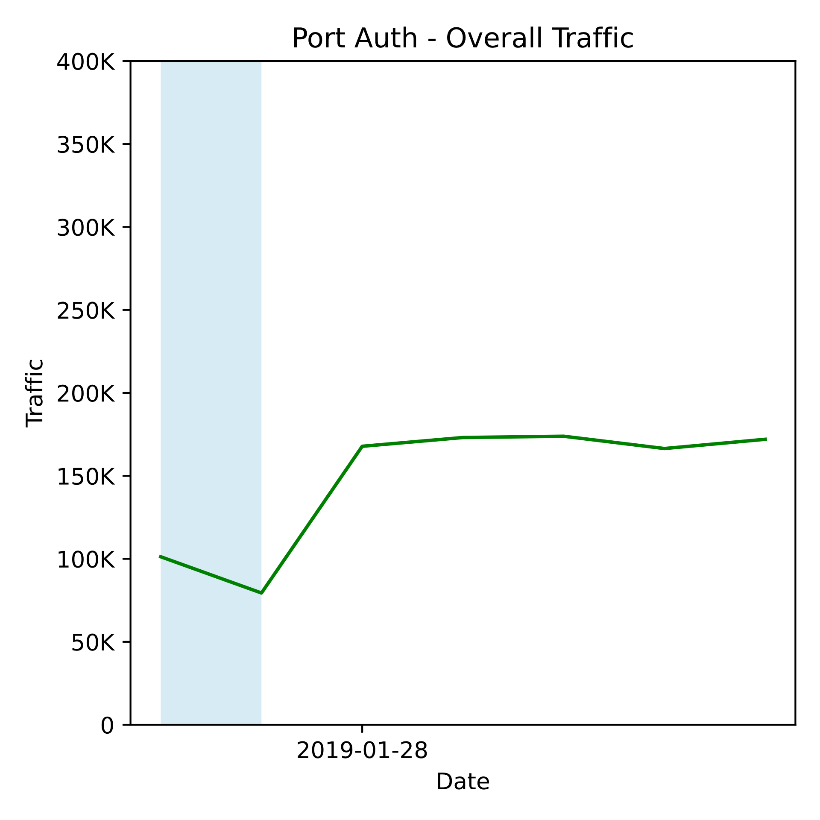
Appendix 1 (contd)

Slide 13
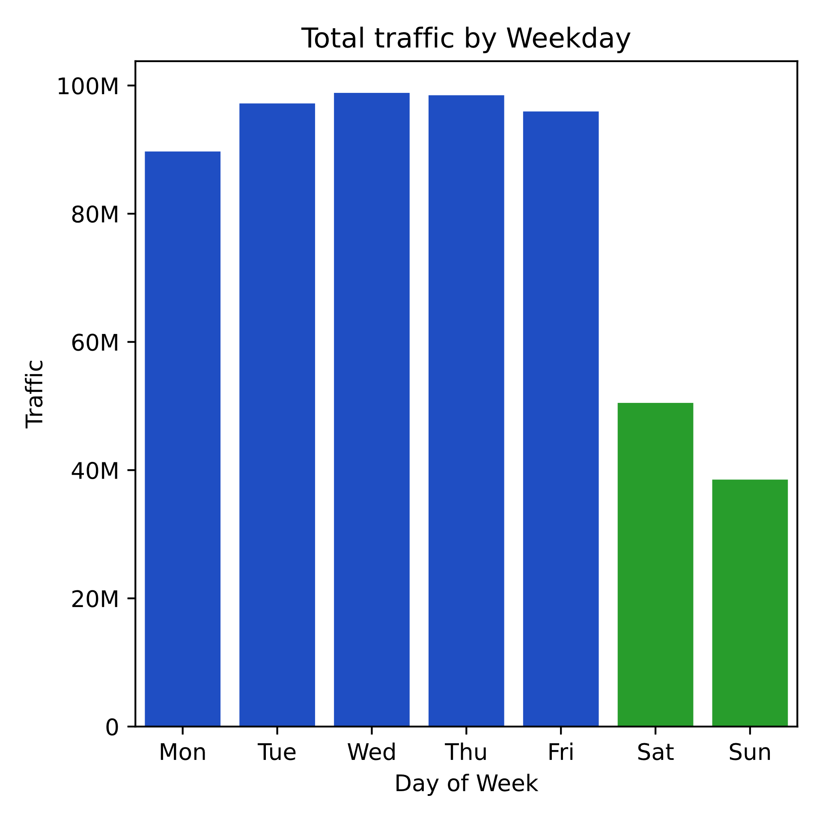
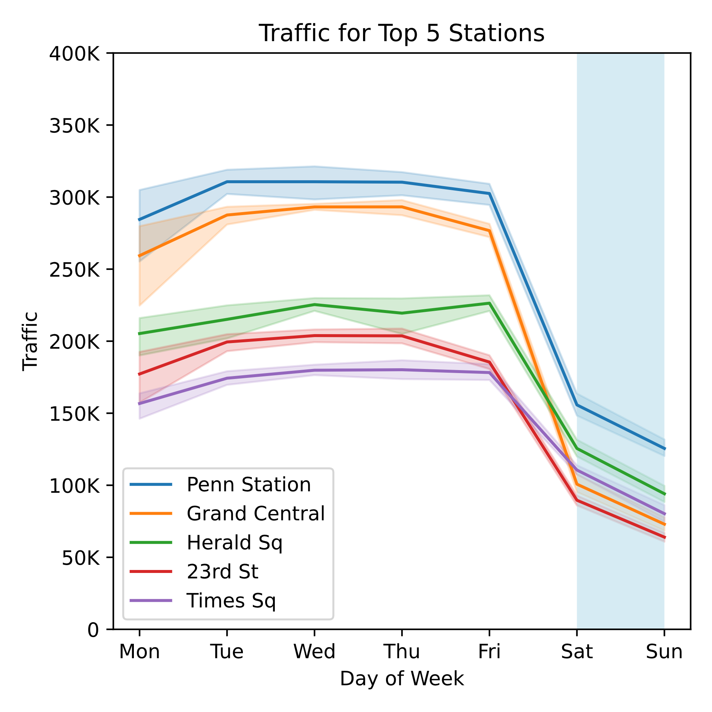
Appendix 2 (10-week overview)

Slide 14
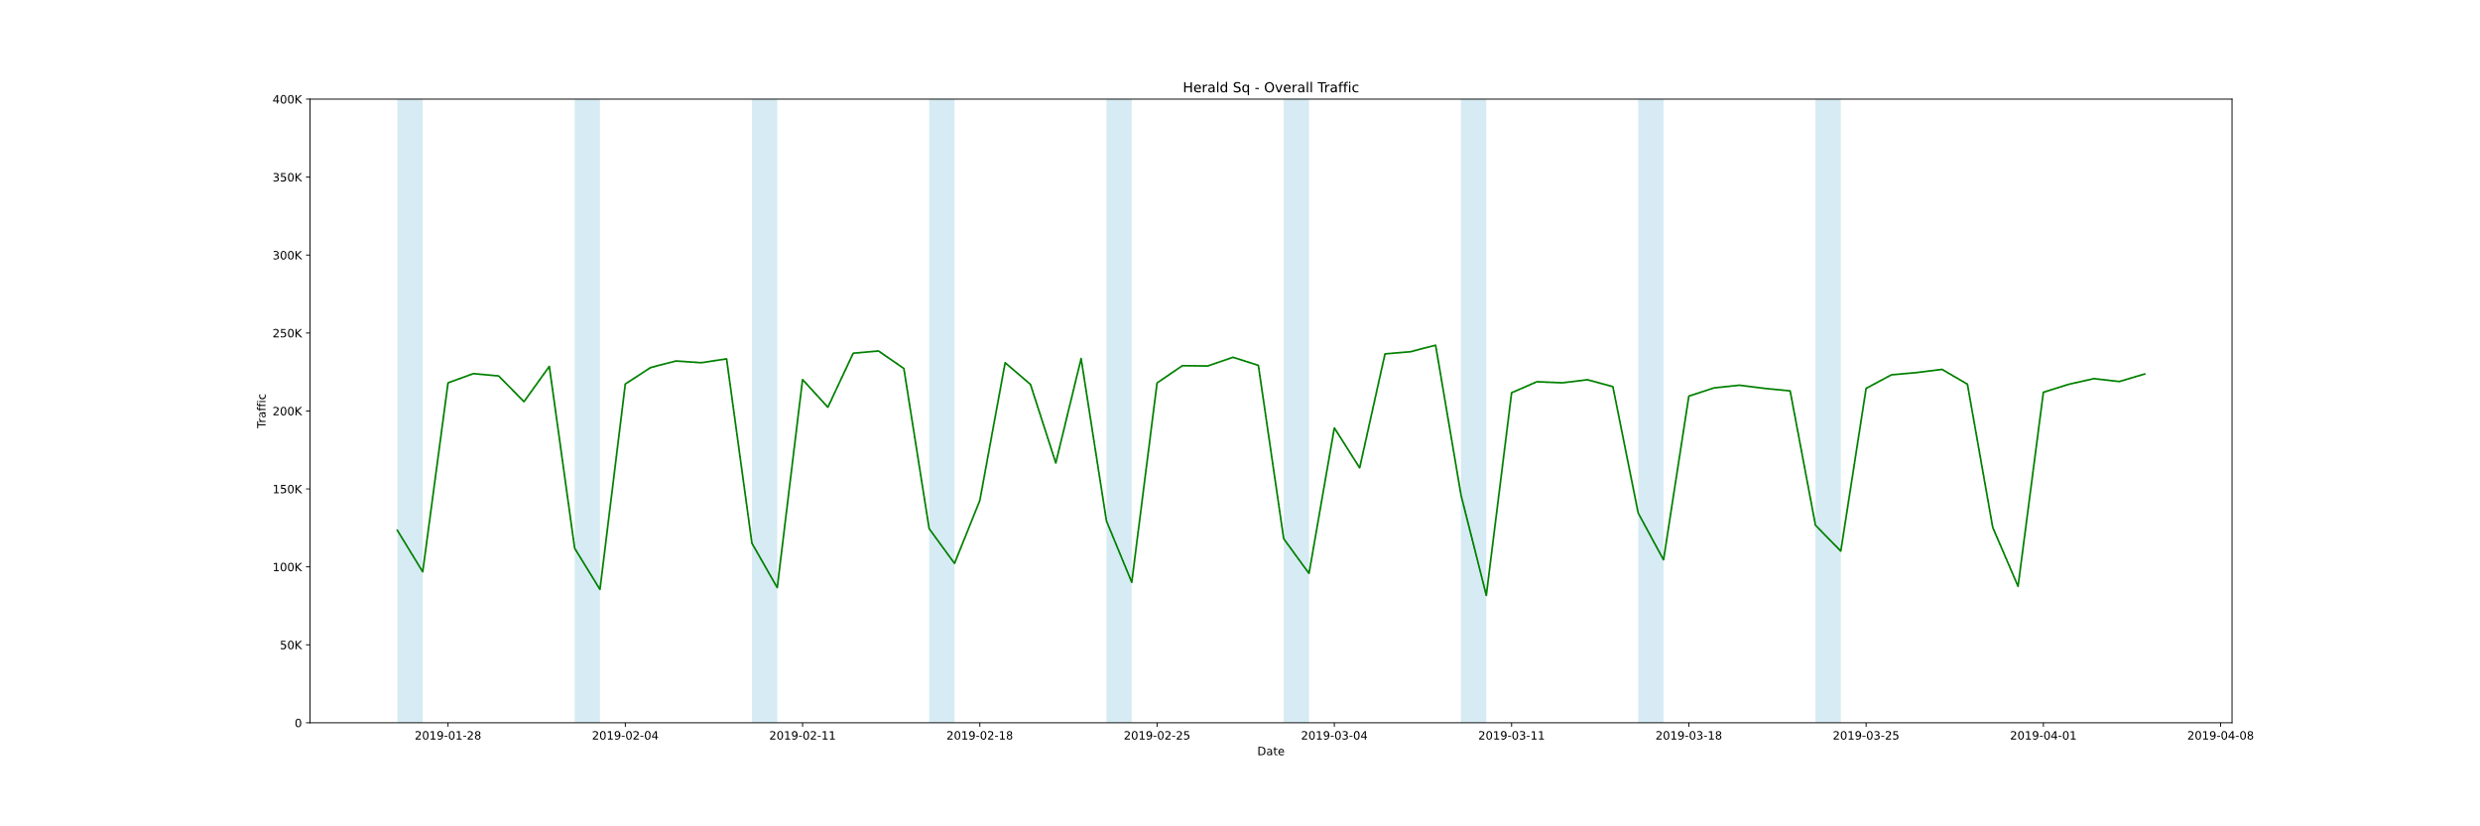
Appendix 3 (fluctuation)

